Slide 1
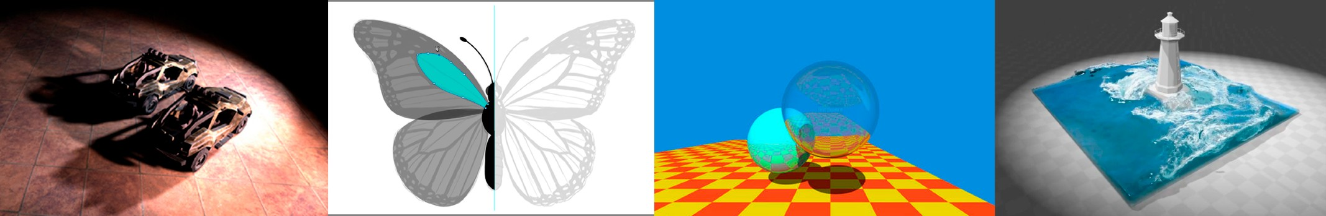
Introduction to Computer Graphics
GMNG 3311 Aobo Jin
Lecture 2: Review of Linear Algebra
http://www.cs.ucsb.edu/~lingqi/teaching/games101.html

Slide 2
Overview
Assignment0
Ubuntu(Linux) and C++
Linear Algebra

Slide 3
Last Lecture
What is Computer Graphics?
Why study Computer Graphics?
Course Topics
Course Logistics

Slide 4
Assignment 0

Slide 5
A Swift and Brutal Introduction to Linear Algebra!
(in fact it’s relatively easy…)

Slide 6
Graphics’ Dependencies
Basic mathematics
Linear algebra, calculus, statistics
Basic physics
Optics, Mechanics
Misc
-
-
Signal processing Numerical analysis
And a bit of aesthetics

Slide 7
This Course
More dependent on Linear Algebra
-
-
Vectors (dot products, cross products, …) Matrices (matrix-matrix, matrix-vector mult., …)
For example,
-
-
A point is a vector (?)
An operation like translating or rotating objects can be matrix-vector multiplication

Slide 8
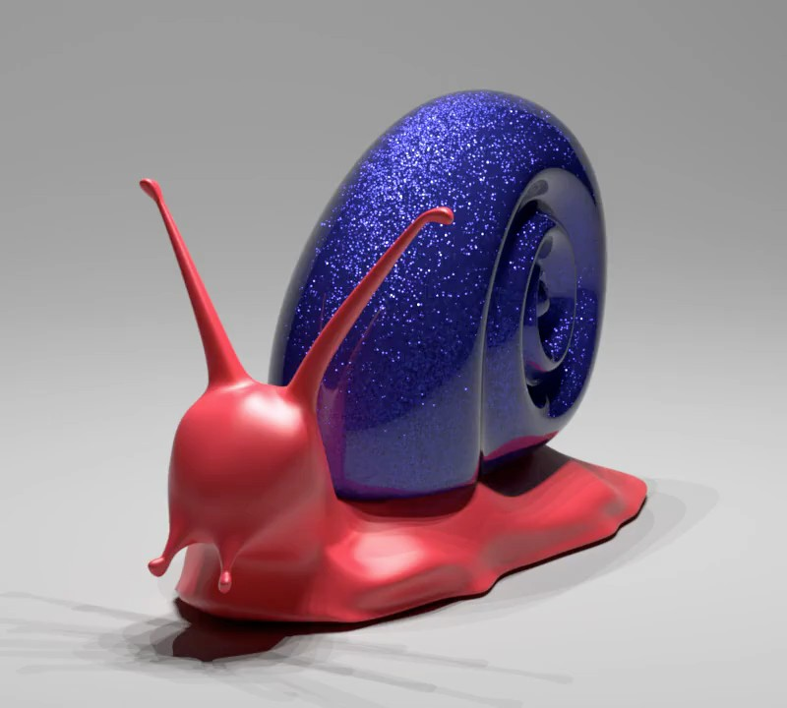
An Example of Rotation
https://cseweb.ucsd.edu/~ravir/glints2014.mp4 (1:22)

Slide 9


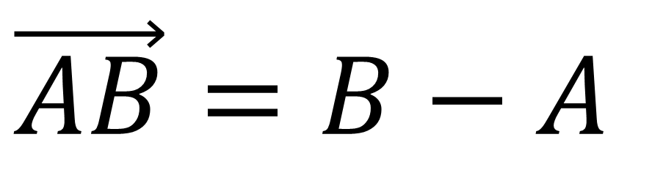
Vectors
B
B’
=
A A’
Usually written as or in bold
Or using start and end points
Direction and length
No absolute starting position
$$\vec{a}$$
$$a$$
$$\vec{AB}=B−A$$

Slide 10


Vector Normalization
Magnitude (length) of a vector written as
Unit vector
$$\left\|a\right\|$$
-
-
-
A vector with magnitude of 1
Finding the unit vector of a vector (normalization):
$$\hat{a}={\vec{a}}/{\left\|a\right\|}$$
Used to represent directions

Slide 11



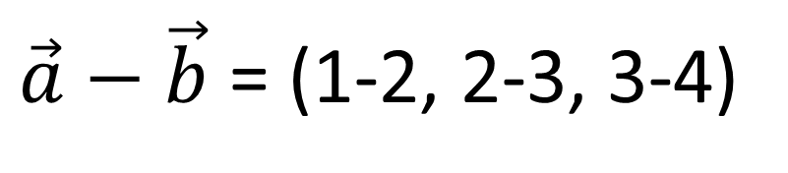


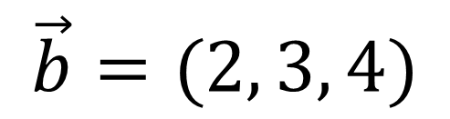

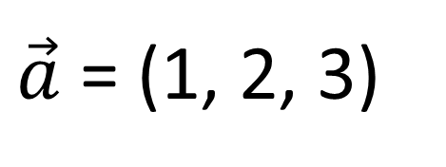


Vector Addition
$$\vec{a}$$
$$\vec{a}+\vec{b}$$
$$\vec{b}$$
$$\vec{a}+\vec{b}$$
$$\vec{b}$$
$$\vec{b}$$
$$\vec{a}$$
$$\vec{a}$$
Geometrically: Parallelogram law & Triangle law
Algebraically: Simply add coordinates
$\vec{a}$ = (1, 2, 3)
$$\vec{b}=(2, 3, 4)$$
$\vec{a}−\vec{b}$ = (1-2, 2-3, 3-4)

Slide 12
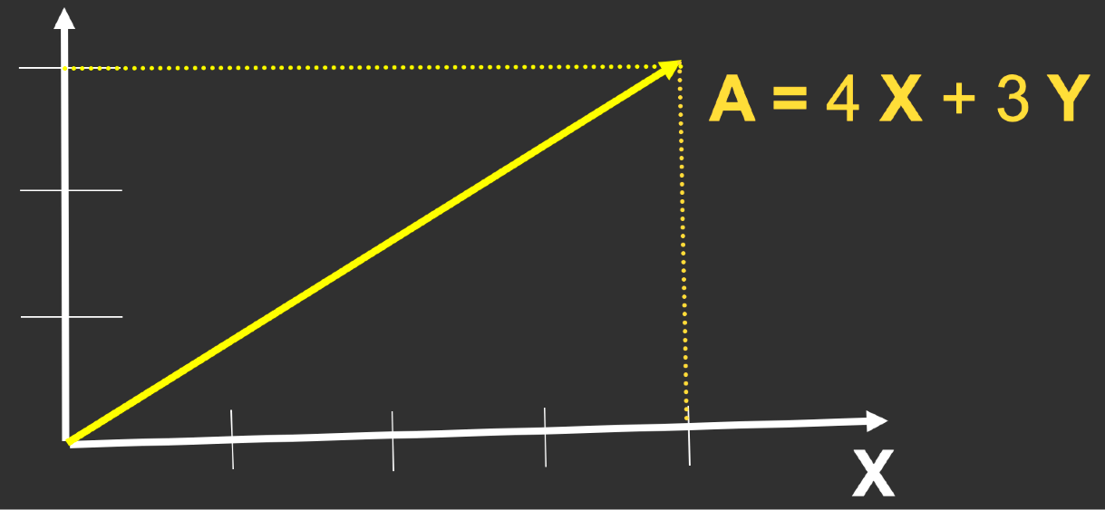
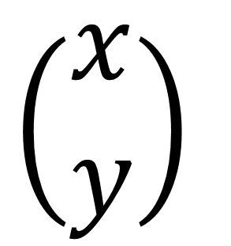
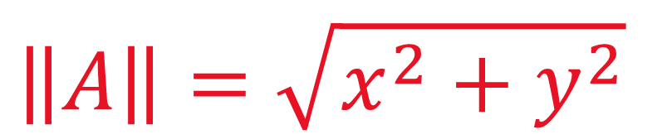
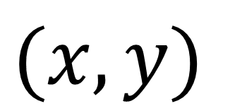
Cartesian Coordinates
X and Y can be any (usually orthogonal unit) vectors
$$\left(\begin{matrix}x \\ y\end{matrix}\right)$$
_{A}T =
$$(x, y)$$
$$\left\|A\right\|=\sqrt{x^{2}+y^{2}}$$
A =

Slide 13
Vector Multiplication
Dot product
Cross product
Orthonormal bases and coordinate frames

Slide 14



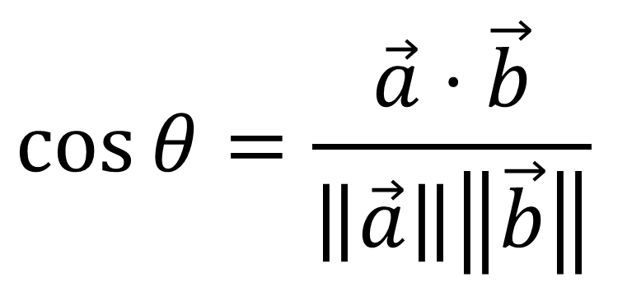
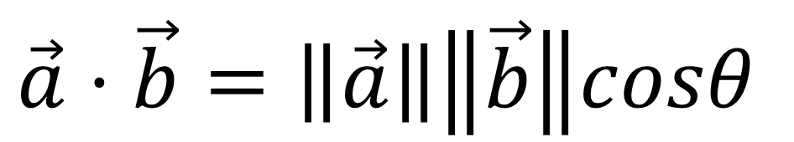

Dot (scalar) Product
$$\vec{b}$$
$$θ$$
$$\vec{a}$$
$$\vec{a}⋅\vec{b}=\left\|\vec{a}\right\|\left\|\vec{b}\right\|cosθ$$
For unit vectors
$$\cos{θ}=\frac{\vec{a}⋅\vec{b}}{\left\|\vec{a}\right\|\left\|\vec{b}\right\|}$$
$$\cos{θ=}\hat{a}⋅\hat{b}$$

Slide 15
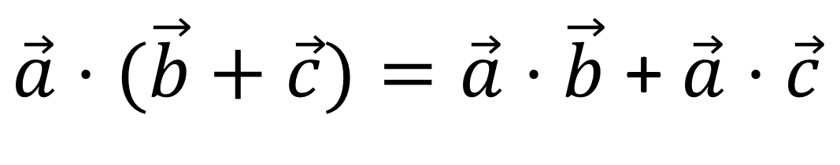
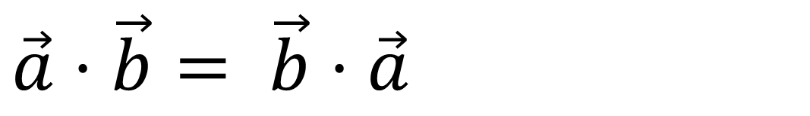
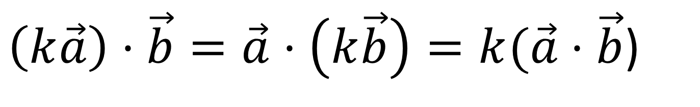
Dot (scalar) Product
Properties
$\vec{a}⋅\vec{b}= \vec{b}$ $⋅\vec{a}$
$\vec{a}⋅(\vec{b}+\vec{c})=\vec{a}⋅\vec{b}$ + $\vec{a}⋅\vec{c}$
$\left(k\vec{a}\right)⋅\vec{b}=\vec{a}⋅\left(k\vec{b}\right)=k(\vec{a}⋅\vec{b}$)

Slide 16
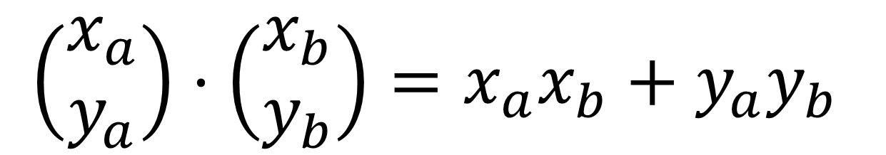
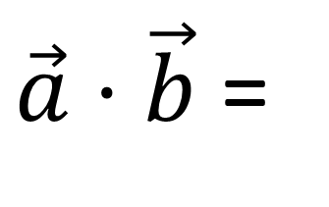
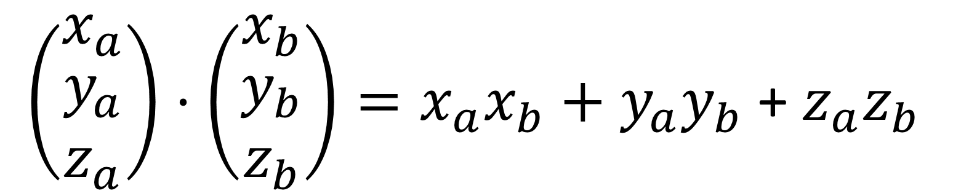
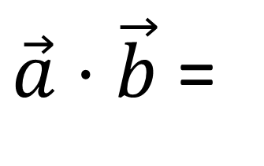
Dot Product in Cartesian Coordinates
Component-wise multiplication, then adding up
- In 2D
$\vec{a}⋅\vec{b}$ =
$$\left(\begin{matrix}x_{a} \\ y_{a}\end{matrix}\right)⋅\left(\begin{matrix}x_{b} \\ y_{b}\end{matrix}\right)=x_{a}x_{b}+y_{a}y_{b}$$
-
In 3D
$\left(\begin{matrix}x_{a} \\ \begin{aligned}y_{a} \\ z_{a}\end{aligned}\end{matrix}\right)⋅\left(\begin{matrix}x_{b} \\ \begin{aligned}y_{b} \\ z_{b}\end{aligned}\end{matrix}\right)=x_{a}x_{b}+y_{a}y_{b}$ + $z_{a}z_{b}$
$\vec{a}⋅\vec{b}$ =

Slide 17
Dot Product in Graphics
Find angle between two vectors
(e.g. cosine of angle between light source and surface)
Finding projection of one vector on another

Slide 18



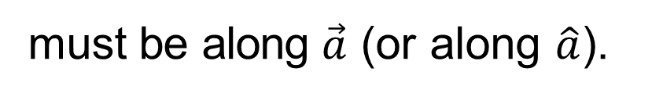


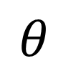

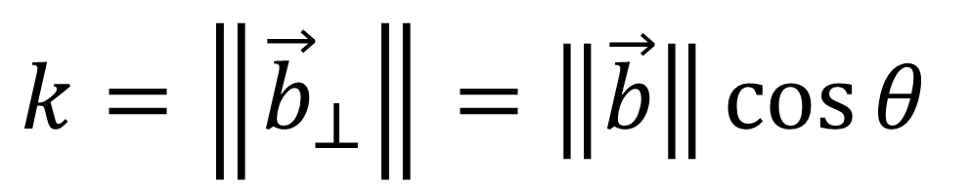
Dot Product for Projection
•
$${\vec{b}}_{⊥}$$
$\vec{b}$ $onto \vec{a}$
: projection of
₋
$${\vec{b}}_{⊥}$$
must be along $\vec{a}$ (or along $\hat{a}$).
$$\vec{b}$$
-
$$θ$$
What’s its magnitude k?
$${\vec{b}}_{⊥}$$
$$\vec{a}$$
$$k=\left\|{\vec{b}}_{⊥}\right\|=\left\|\vec{b}\right\|\cos{θ}$$

Slide 19

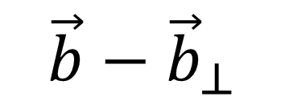



Dot Product in Graphics
Measure how close two directions are
$$\vec{b}−{\vec{b}}_{⊥}$$
$$\vec{b}$$
Decompose a vector
Determine forward / backward
$$θ$$
$${\vec{b}}_{⊥}$$
$$\vec{a}$$

Slide 20



Dot Product in Graphics
$$\vec{a}$$
$$\vec{b}$$
Measure how close two directions are
Decompose a vector
Determine forward / backward
forward
backward
$$\vec{c}$$

Slide 21
Vector Multiplication
Dot product
Cross product
Orthonormal bases and coordinate frames

Slide 22
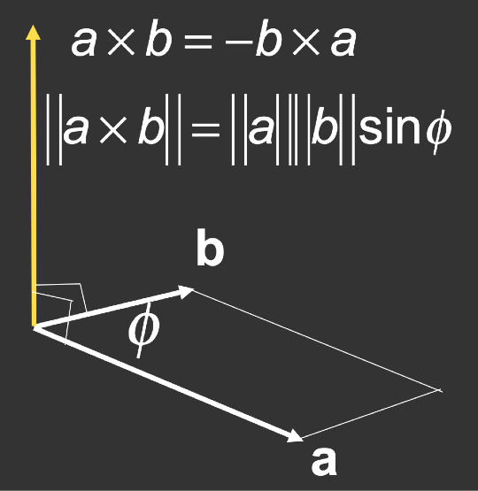
Cross (vector) Product
Cross product is orthogonal to two initial vectors
Direction determined by right-hand rule
Useful in constructing coordinate systems (later)

Slide 23
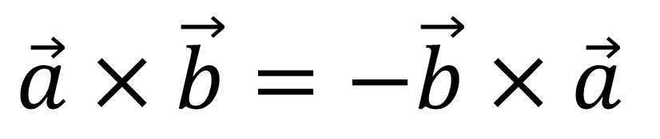
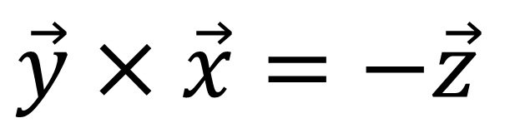
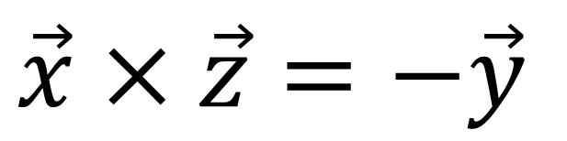
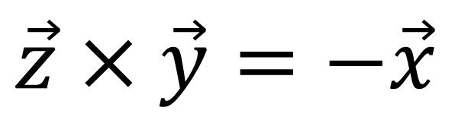
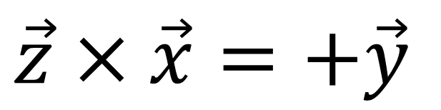
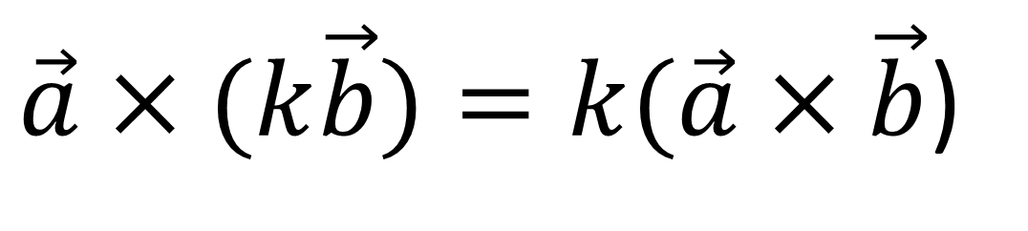
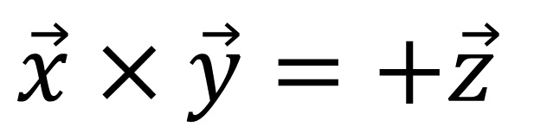
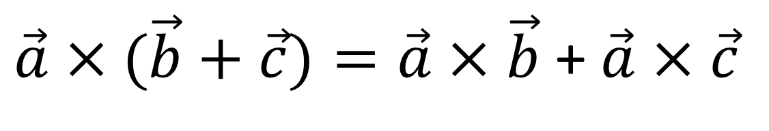
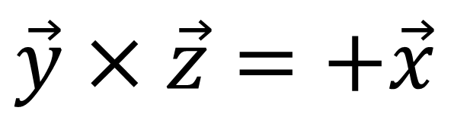
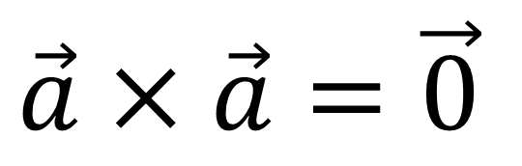
Cross product: Properties
$$\vec{x}×\vec{y}=+\vec{z}$$
$$\vec{a}×\vec{b}=−\vec{b}×\vec{a}$$
$$\vec{y}×\vec{x}=−\vec{z}$$
$$\vec{a}×\vec{a}=\vec{0}$$
$$\vec{y}×\vec{z}=+\vec{x}$$
$$\vec{z}×\vec{y}=−\vec{x}$$
$\vec{a}×(\vec{b}+\vec{c})=\vec{a}×$ $\vec{b}$ + $\vec{a}×$ $\vec{c}$
$$\vec{z}×\vec{x}=+\vec{y}$$
$\vec{a}×(k\vec{b})=k(\vec{a}$ $×\vec{b}$)
$$\vec{x}×\vec{z}=−\vec{y}$$

Slide 24
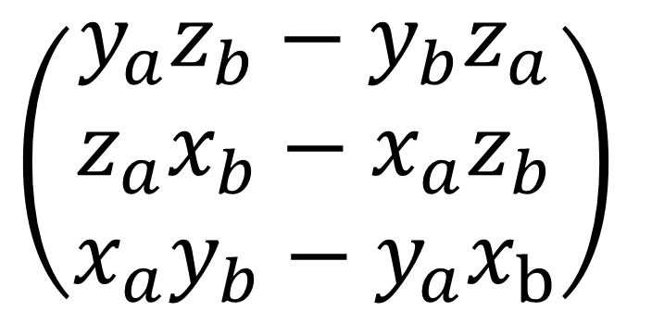
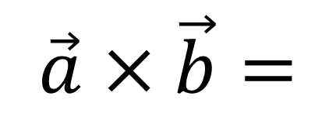
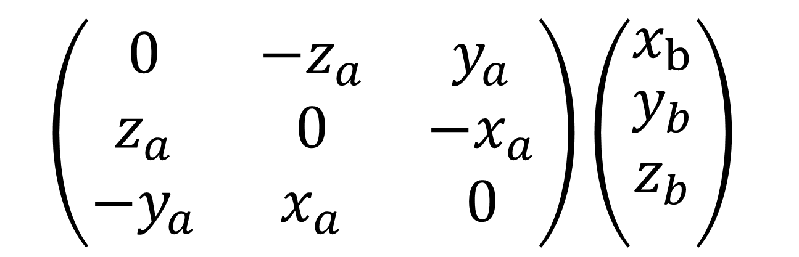
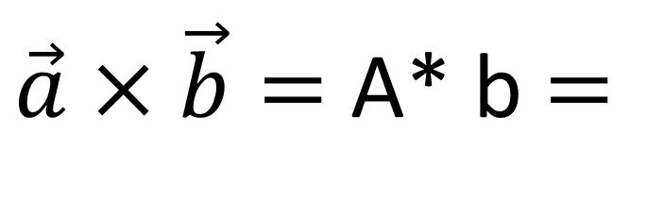
Cross Product: Cartesian Formula?
$$\left(\begin{matrix}y_{a}z_{b}−y_{b}z_{a} \\ z_{a}x_{b}−x_{a}z_{b} \\ x_{a}y_{b}−y_{a}x_{b}\end{matrix}\right)$$
$$\vec{a}×\vec{b}=$$
Later in this lecture
$$\left(\begin{matrix}0 & −z_{a} & y_{a} \\ z_{a} & 0 & −x_{a} \\ −y_{a} & x_{a} & 0\end{matrix}\right)\left(\begin{matrix}x_{b} \\ \begin{aligned}y_{b} \\ z_{b}\end{aligned} \\ \end{matrix}\right)$$
$\vec{a}×\vec{b}=$ A* b $=$
dual matrix of vector a

Slide 25


Cross Product in Graphics
$$\vec{b}$$
Determine left / right
Determine inside / outside
$$\vec{b}$$
$$θ$$
$$\vec{a}$$

Slide 26



Cross Product in Graphics
A
$$\vec{b}$$
y
P
$$\vec{a}$$
x
z
B
C

Slide 27
Vector Multiplication
Dot product
Cross product
Orthonormal bases and coordinate frames

Slide 28
Orthonormal Bases / Coordinate Frames
Important for representing points, positions, locations
Often, many sets of coordinate systems
Global, local, world, model, parts of model (head,
hands, …)
Critical issue is transforming between these systems/ bases
A topic for next week

Slide 29
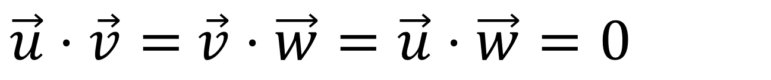
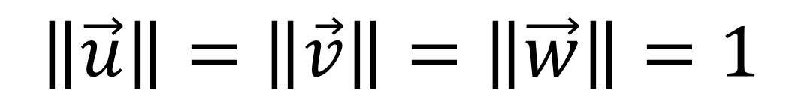
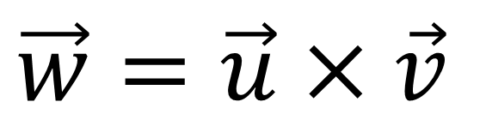
Orthonormal Coordinate Frames
Any set of 3 vectors (in 3D) that
$$\left\|\vec{u}\right\|=\left\|\vec{v}\right\|=\left\|\vec{w}\right\|=1$$
$\vec{u}⋅\vec{v}=$ $\vec{v}⋅\vec{w}=\vec{u}⋅\vec{w}=0$
$$\vec{w}=\vec{u}×\vec{v}$$
(right-handed)
$\vec{p}=(\vec{p}⋅\vec{u})\vec{u}=(\vec{p}⋅\vec{v})\vec{v}$ $=(\vec{p}⋅\vec{w})\vec{w}$
(projection)

Slide 30
Questions?

Slide 31
Matrices
Magical 2D arrays that haunt in every CS course
In Graphics, pervasively used to represent transformations
- Translation, rotation, shear, scale (more details in the next lecture)

Slide 32
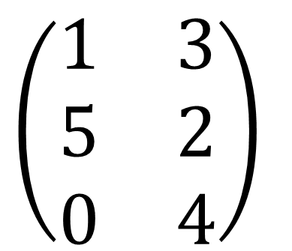
What is a matrix
Array of numbers (m × n = m rows, n columns)
$$\left(\begin{matrix}1 & 3 \\ 5 & 2 \\ 0 & 4\end{matrix}\right)$$
Addition and multiplication by a scalar are trivial: element by element

Slide 33


Matrix-Matrix Multiplication
# (number of) columns in A must = # rows in B (M x N) (N x P) = (M x P)
$$\left(\begin{matrix}1 & 3 \\ 5 & 2 \\ 0 & 4\end{matrix}\right)$$
$$\left(\begin{matrix}3 & 6 & 9 & 4 \\ 2 & 7 & 8 & 3\end{matrix}\right)$$

Slide 34



Matrix-Matrix Multiplication
# (number of) columns in A must = # rows in B (M x N) (N x P) = (M x P)
$$\left(\begin{matrix}1 & 3 \\ 5 & 2 \\ 0 & 4\end{matrix}\right)$$
=$\left(\begin{matrix}9 & ? & 33 & 13 \\ 19 & 44 & 61 & 26 \\ 8 & 28 & 32 & ?\end{matrix}\right)$
$$\left(\begin{matrix}3 & 6 & 9 & 4 \\ 2 & 7 & 8 & 3\end{matrix}\right)$$
Element (i, j) in the product is
the dot product of row i from A and column j from B

Slide 35
Matrix-Matrix Multiplication
Properties
Non-commutative
(AB and BA are different in general)
Associative and distributive
-
-
-
(AB)C=A(BC) A(B+C) = AB + AC (A+B)C = AC + BC

Slide 36

Matrix-Vector Multiplication
Treat vector as a column matrix (m×1)
Key for transforming points (next lecture)
Oﬃcial spoiler: 2D reflection about y-axis
$$\left(\begin{matrix}−1 & 0 \\ 0 & 1\end{matrix}\right)\left(\begin{matrix}x \\ y\end{matrix}\right)=\left(\begin{matrix}−x \\ y\end{matrix}\right)$$

Slide 37

Transpose of a Matrix
Switch rows and columns (ij -> ji)
$${\left(\begin{matrix}1 & 2 \\ 3 & 4 \\ 5 & 6\end{matrix}\right)}^{T}=\left(\begin{matrix}1 & 3 & 5 \\ 2 & 4 & 6\end{matrix}\right)$$
Property
(AB)^{T}
= B^{T} A^{T}

Slide 38


Identity Matrix and Inverses
$$I_{3×{3}}=\left(\begin{matrix}1 & 0 & 0 \\ 0 & 1 & 0 \\ 0 & 0 & 1\end{matrix}\right)$$
AA^{—1} = A^{—1}A = $I$
(AB)^{—1} = B^{—1}A^{—1}

Slide 39



Vector multiplication in Matrix form
Dot product?
$\vec{a}⋅\vec{b}={\vec{a}}^{T}\vec{b}=\left(x_{a}{ y}_{a}{ z}_{a}\right)\left(\begin{matrix}x_{b} \\ y_{b} \\ z_{b}\end{matrix}\right)=$($x_{a}x_{b}+y_{a}y_{b}$+ $z_{a}z_{b})$
Cross product?
$$\left(\begin{matrix}0 & −2a & y_{a} \\ z_{a} & 0 & −x_{a} \\ −y_{a} & x_{a} & 0\end{matrix}\right)\left(\begin{matrix}x_{b} \\ \begin{aligned}y_{b} \\ z_{b}\end{aligned} \\ \end{matrix}\right)$$
$\vec{a}×\vec{b}=$ A *b $=$
dual matrix of vector a

Slide 40

An Example of General Transformation
The Sponza Scene, rendered by Lingqi Yan using Real-time Ray Tracing (RTRT)

Slide 41
Questions?

Slide 42

Next
Transform!
Transformers: The Last Knight, 2017 movie
41

Slide 43
Thank you!
(And thank Prof. Ravi Ramamoorthi, Prof. Ren Ng, and Prof. Lingqi Yan for many of the slides!)

